Slide 1

Connect Four Game

Slide 2

: What You Need to Know
Project Description
Impact of Extension
Requirements
Testing Strategies
Design Options and Decisions
Lessons Learned

Slide 3
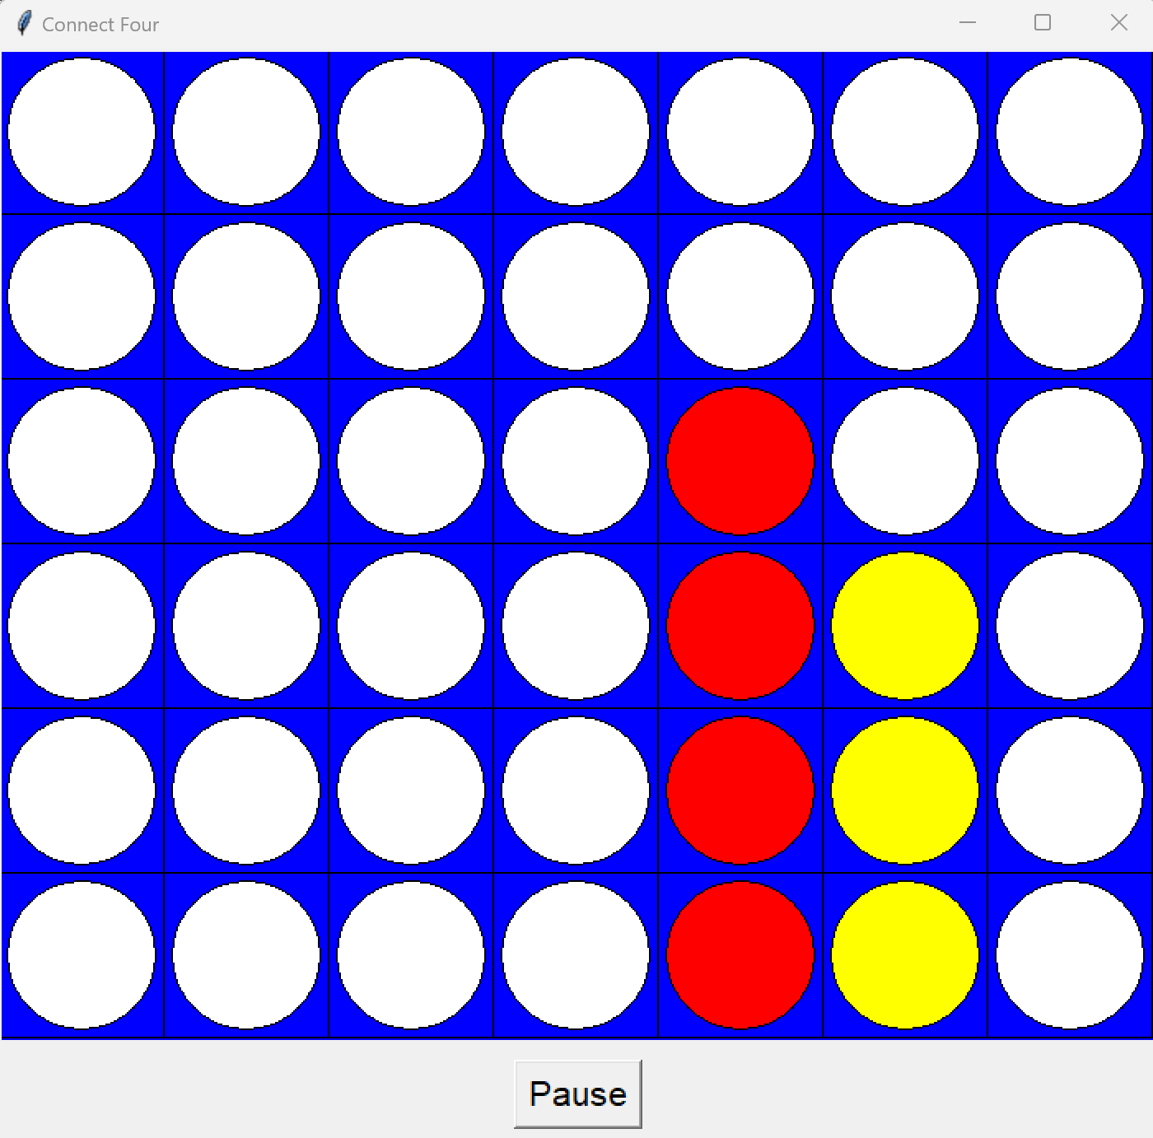
Connect Four
We developed a classic Connect Four game using Python and the Tkinter library.
Objective: Players take turns dropping colored discs into a grid. The goal is to connect four of one's own discs in a row, column, or diagonal before the opponent.

Slide 4
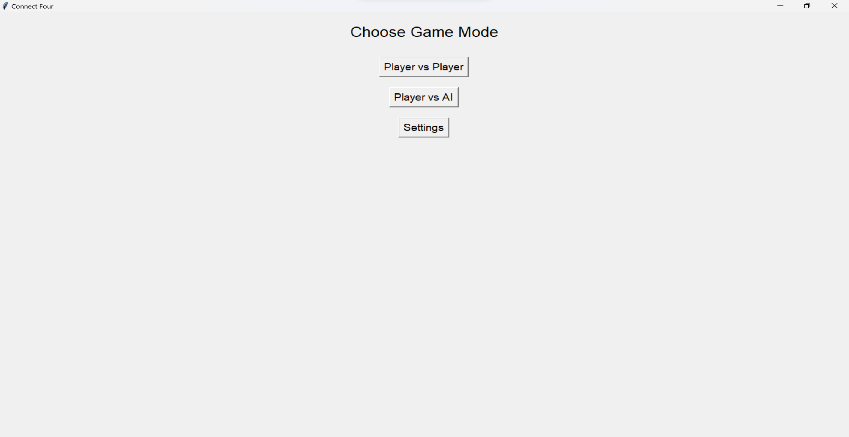
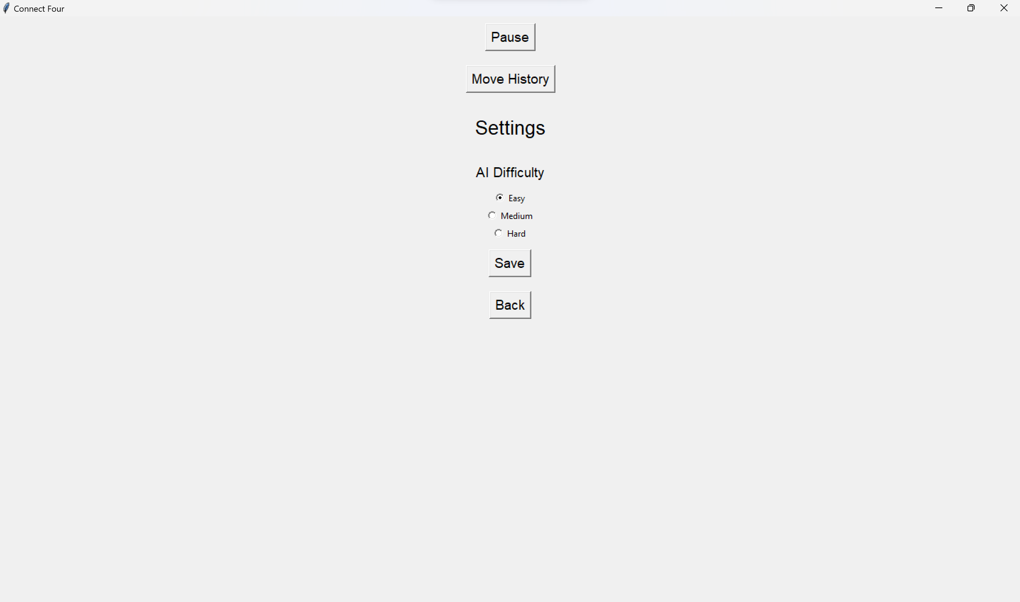
Requirements
Game Modes: Two-player mode and Player vs. AI mode
AI Difficulty: Players can adjust the AI difficulty level.
Additional Features: Game pausing and resuming, move history display.

Slide 5

Design Options and Decisions
Design Aspect | Options Considered | Decision | Pros | Cons
AI implementation strategy | Rule Based AI | Used due to its simplicity and manageability within the scope | Easier to implement and debug | Lack of strategic depth
Game State Management | Global state management, Class based design | Used to show the game logic and state within the ‘Connect Four’ class. | Improved Code Organization, easier to extend functionality, encapsulation of game state and behavior | Bit more complex to set up initially compared to using global variables
GUI(Graphical user Interface) | Command Line Interface(CLI), Use of Tkinter Library | To provide more engaging and interactive user experience. | Enhanced User Experience, visual representation of game state and easier for users to interact with the game | Requires additional development time and effort to create and manage the graphical components.

Slide 6

Impact of Extension
A.I
Design Influence: AI addition required seamless integration with the game logic.
AI Difficulty Levels: Developed multiple levels to adjust to different player skills.
Balancing Challenge: Ensured AI is challenging but fair to provide an enjoyable experience.

Slide 7

Testing Strategies
Game Logic: Verified the correctness of player moves and win conditions.
State Transitions: Tested pausing and resuming functionalities.
AI Behavior: Ensured AI responses were logical and varied by difficulty.
Equivalence Classes: Included tests for valid/invalid moves, column full, player vs player, player vs AI, move history, draw condition and exit game.

Slide 8
Lessons Learned:
Programming Concepts
Software process
Team Collaboration
Enhanced understanding of GUI programming, object-oriented design, and AI algorithms.
Appreciated the value of iterative development and comprehensive testing.
Recognized the importance of clear communication and teamwork.

Slide 9

Thank You

Slide 10

Do you have
any questions?

